Slide 1
Obligations and Responsibilities of a Youth Baseball Coach
Israel Association of Baseball

Slide 2
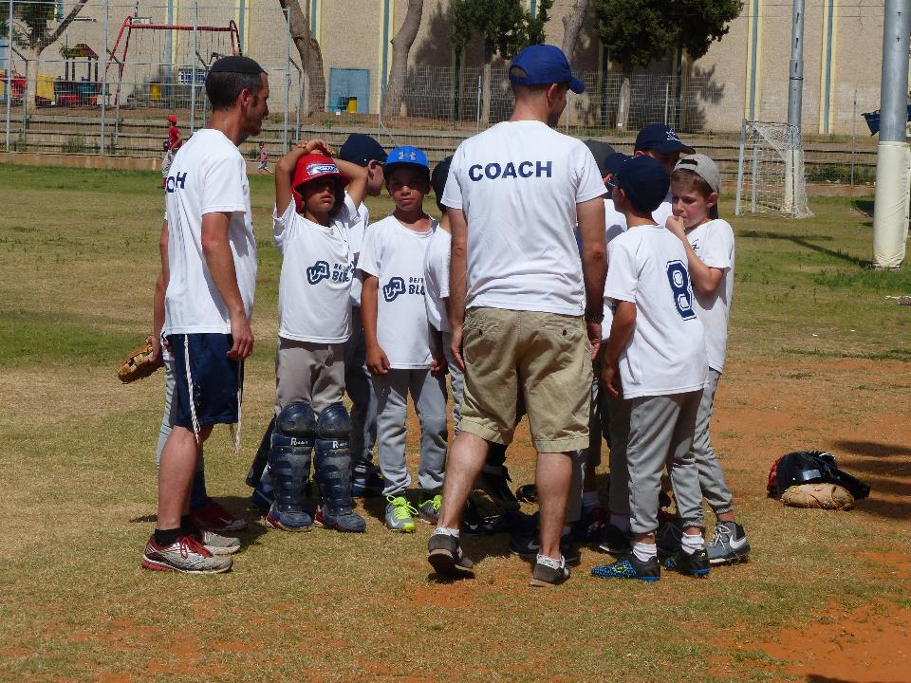
What is a youth coach?

Slide 3
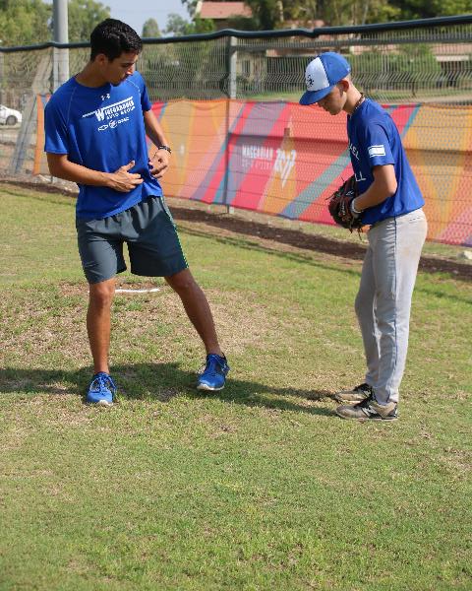
As a youth-baseball coach, we have an impact on children and young adults in their formative years
The way we act and what we say may influence their personalities as they grow older. This is a great responsibility - a good coach will feel obligated to fulfill this responsibility conscientiously.

Slide 4
The youth-baseball coach wears three hats
Educator and Trainer
Safety Instructor
Role model

Slide 5
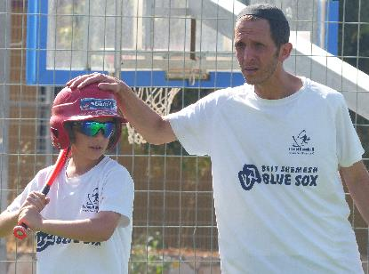
Safety Instructor
Adopt safety rules
The health, safety and welfare of your players are your first priority during practice as well as in the game
Safety requires careful thought and preparation – arrive a few minutes early to supervise players who arrive early and start practicing
Be the last to leave, ensuring that all the players have left in proper care
If a parent is late to pick up a child do not leave the child alone, make sure they are picked up
Talk to the parent so it doesn't happen again
When organizing travel arrangements for games and other logistics, always keep the parents informed

Slide 6
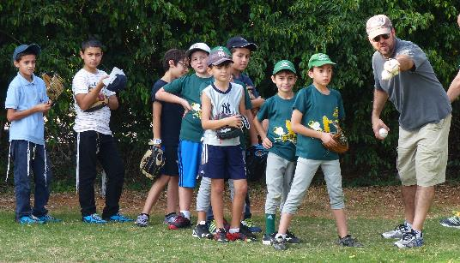
Safety Instructor
Teach safety rules
Always know where all the players are and what they are doing
Be aware of what is going on in a general sense even when giving individual instruction
Where necessary, enlist parents to help - parents can be a blessing if they are “Part of the Team”

Slide 7
Safety Instructor
Safety’s everyone’s responsibility
Have a first aid kit handy
Ensure all players are registered for insurance
Have money on hand for emergencies
Have a back-up plan if someone needs further attention
Know where the nearest hospital is and how to get the player to the hospital
Contact the parents
Appoint someone to take charge of the rest of the team
Decide what happens to the equipment
Younger coaches should always have a responsible adult present

Slide 8
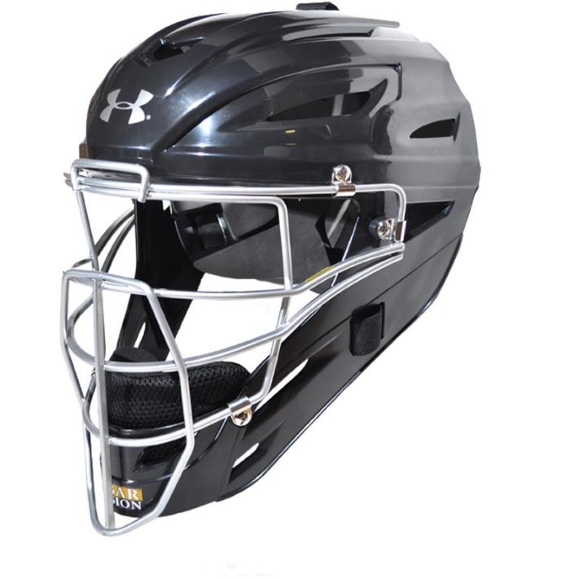
Safety Instructor
Safety-first during play – share this with your players
All players on the field must wear a glove and be alert at all times
Players must wear long pants and a baseball cap with the peak facing forward
Batters and base runners must wear helmets
The catcher must wear all of his protective equipment even when warming up a pitcher
Never throw a bat after batting; place it on the ground
Never pick up and swing a bat unless it’s your turn to bat, you’re on deck or the coach is instructing you.
Do not throw a baseball to another player if he is not paying attention, even if the play calls for a throw to that player
Players waiting for their turn at bat should stay clear of possible foul balls
Players should point out potentially dangerous situations to the coach; add it to the safety rules

Slide 9
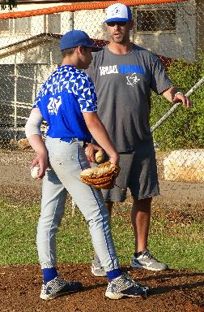
Instructor and Educator
As an instructor you have an obligation to teach and impart knowledge to the players – this obligates you to learn the fundamentals of the subject
Read the rule book and any other coaching manuals you can find
Watch videos
Attend clinics
Check out the material in the Coaches Corner on the IAB website
Learn the league rules of your age group – you can find them on our website
Not knowing the rules or breaking them may result in forfeits and disqualification and may rob the players of their chance to play in championship tournaments
Remember, if you teach it wrong, the next coach will first have to “un-teach” the players, before he can re-teach them

Slide 10
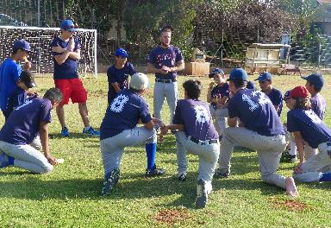
Instructor and Educator
Make a lesson plan, don't wing it
Strive to move ahead and improve with each practice
Be goal-orientated with the practices
Recognize and record progress.
Teach the mechanics of baseball as well as the mental skills
General awareness, planning ahead, concentration, self-confidence, team play
Take care of your equipment
Assign duties to players
Add specific plays to your weekly email to the team (Hebrew and English), e.g., force play verses tag play, double plays, pop-ups/outs, base running, rundowns, etc.

Slide 11
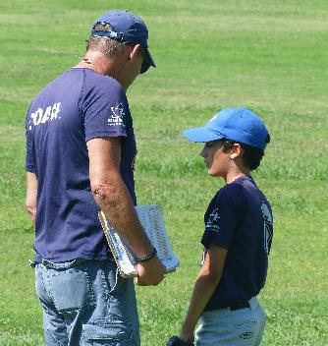
Role Model
As a role model, the way you act will influence your players (and their parents) on the field and elsewhere
You expect the players to come dressed for play (cap and long pants) you should too
Obey all safety rules - they are not just for the players
Do not use foul language, smoke or drink alcohol
Be energetic and hustle
Be serious about teaching the game and expect the players to be serious about learning the game
Never cheat
Respect the umpire's decisions: Be calm when discussing a call with the umpire, do not blame the umpire, the field or individual players for poor play or losing a game
If you earn respect, there is no need to demand it
Do the right thing

Slide 12
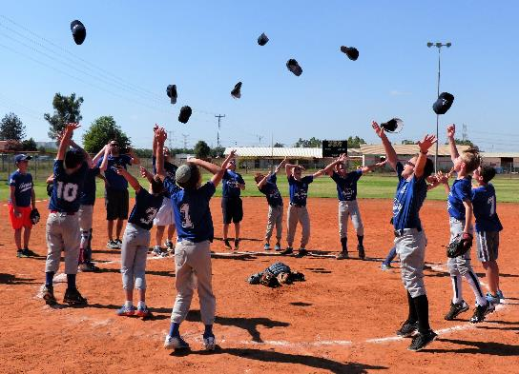
And don’t forget…
Have fun and make sure your players are too!!!

